Slide 1

Lesson: 3.04 Debugging and Scope
Microsoft Philanthropies TEALS Program
Introduction to Computer Science
Semester 2

Slide 2
Debugging and Scope
After this lesson, you will be able to...
Define and identify scope, aliasing, stack trace
Demonstrate that changing a list inside a function updates the list outside of the function
Demonstrate that updating variables in a function does not affect the variable outside of the function
Demonstrate the use of global variables
Draw a simple stack trace

Slide 3
Plan
Do Now
Lesson
Lab/Review
Debrief
Notes:
5 Minutes - Do Now
10 Minutes - Lesson
30 Minutes - Lab/Review
10 Minutes - Debrief

Slide 4
Do Now
In your notebook, write down one thing you learned in the previous class.
Rank the following from easiest to hardest:
Importing built-in functions
Using randint
Abstraction/creating functions
Passing int/str/float/bool arguments into functions
Calling a function
List syntax
Return vs print
Type the following into the console:
my_list = ['a', 'b', 'c', 'd']
# input: a list of strings
# output: None
def my_function(list_argument):
list_argument[0] = 'z'
print("Inside function:", my_list)
print("Before function:", my_list)
my_function(my_list)
print("After function:", my_list)
Notes:
We will have a quiz next class covering all of the above topics. Is there any topic you would like to focus on and cover more of?
Ask the students the following?
What happened? Try writing a similar program but passing in integers instead of a list. What happens?

Slide 5
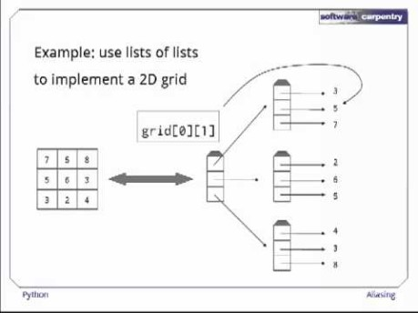
Aliasing
Aliasing – Data in memory that has multiple variables associated with it.
Notes:
Video direct link -https://youtu.be/7m_cw30tyr0
Video attribution - https://software-carpentry.org/

Slide 6
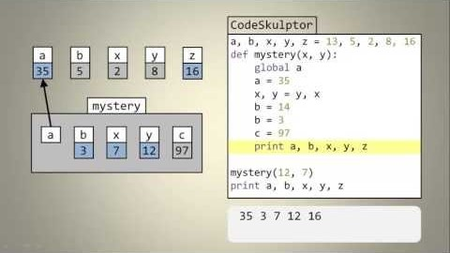
Variable Scope
Scope of functions - variable scope is the part of a program where a variable is accessible.
Global Variable –
A variable which is defined in the main body of a file is called a global variable.
Global variables are defined outside of a function and used in many different functions.
Global variables are often used for constants.
NOTE: We use the 'ALL_CAPS' convention for global variables.
Notes:
Video Direct Link
https://www.youtube.com/watch?v=A054Ged9suI-

Slide 7
Lesson (continued)
Local Variables
Variables available inside functions include the function parameters, the variables defined in the function, and variables declared as global.
Local variables of functions can't be accessed from outside code when the function call has finished.
Debugging
Print statements throughout your code can let you know where in the program things are not operating as expected.
Notes:
Demonstrate how to draw the Stack Diagrams shown in the course book (found in section 3.4) and explain how they show the scope of variables as they related to functions.
Point out the error messages that will occur if you use a variable out of its scope.

Slide 8
Discussion - Conventions
Programming languages frequently have conventions. For instance:
Function and variable names should be lowercase, with words separated by underscores as necessary to improve readability.
Constants are usually defined on a module level and written in all capital letters with underscores separating words.
Examples include MAX_OVERFLOW and TOTAL.
Notes:
https://www.python.org/dev/peps/pep-0008/#function-and-variable-names
https://www.python.org/dev/peps/pep-0008/#constants

Slide 9
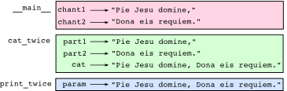
Stack Diagram
A Stack Diagram shows the scope of variables as they relate to functions.
You will receive an error message if you use a variable out of its scope.

Slide 10
Lab Part 1 - Aliasing
a = [1, 2, 4]
b = a
Will updating b affect a? Explain why or why not.
# input: a list of ints
# output: an int
def update_list(a_list):
a_list[3] = "yo"
b = a_list[4]
b = 100
my_list = [1, 2, 3, 4, 5]
update_list(my_list)
Print(my_list)
Predict what the my_list list will print out when this code is run. If you are not sure, test the code by copying and running it.

Slide 11
Lab Part 2 - Scope
Draw a stack diagram for the following:
var_1 = "kittens"
var_2 = "cookies"
# input: a string
# output: a string
def my_function(my_favorite_things):
song_lyrics = "raindrops on roses, "
combined_song = song_lyrics + my_favorite_things
return combined_song
# input: a string
# output: a string
def my_function_2(item, item2):
full_lyrics = item + " on " + item2
full_song = my_function(full_lyrics)
return full_song
my_song = my_function_2(var_1, var_2)
Notes:
var_1 = "kittens"
var_2 = "cookies"
# input: a string
# output: a string
def my_function(my_favorite_things):
song_lyrics = "rain drops on roses,"
combined_song = song_lyrics + my_favorite_things
return combined_song
# input: a string
# output: a string
def my_function_2(item, item2):
full_lyrics = item + "on " + item2
full_song = my_function(full_lyrics)
return full_song
my_song = my_function_2(var_1, var_2)

Slide 12
Lab Part 2 - Practice 1
Write down what (if anything) is wrong with the following code.
If there is an issue, write out how to fix it.
var_1 = 'cat'
var_2 = 'dog'
def print_out_my_favorite(favorite_pet):
if favorite_pet == var_1:
print("My favorite pet is the cat.")
if favorite_pet == var_2:
print("My favorite pet is the dog.")
var_1 = "dog"
var_2 = "cat"
print_out_my_favorite(var_1)
print("var_1:" + var_1 + " var_2:" + var_2)

Slide 13
Lab Part 2 - Practice 2
Write down what (if anything) is wrong with the following code.
If there is an issue, write out how to fix it.
var_1 = 'cat'
var_2 = 'dog'
def print_out_my_favorite(favorite_pet):
var_1 = 'dog'
var_2 = 'cat'
if favorite_pet == var_1:
print("My favorite pet is the cat.")
if favorite_pet == var_2:
print("My favorite pet is the dog.")
print_out_my_favorite(var_1)
print("var_1:" + var_1 + " var_2:" + var_2)

Slide 14
Lab Part 2 - Practice 3
Write down what (if anything) is wrong with the following code.
If there is an issue, write out how to fix it.
var_1 = 'cat'
var_2 = 'dog'
def print_out_my_favorite(favorite_pet):
if favorite_pet == var_1:
print("My favorite pet is the cat.")
if favorite_pet == var_2:
print("My favorite pet is the dog.")
print_out_my_favorite(var_1)
print("var_1:" + var_1 + " var_2:" + var_2)

Slide 15
On Your Own
Write a program that has a global variable, my_num.
Create three functions that update my_num:
add2: this function adds 2 to my_num
multiply_num: this function takes in a parameter, multiplier, and multiplies my_num by that parameter
add2_and_multiply: this function takes in a parameter, multiplier, calls add2, then calls multiply_num.
Complete the program by writing code in the main part of the program that:
sets my_num to some initial value you choose
prints my_num
calls add2_and_multiply() with some argument you choose
prints the final value of my_num
Confirm that the printed values match what you expected.

Slide 16
Exit Ticket/Debrief
Concepts covered today: scope, aliasing, and stack traces.
In your notebook, write down two things that you learned today.
Notes:
Call a few students to the board to draw their stack traces from the lab and talk through them.

